Slide 1
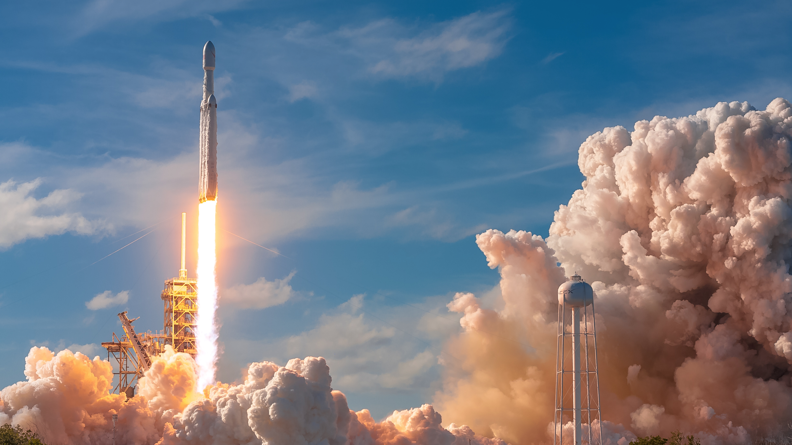

JOEL BRENDLE

Slide 2

- About - Rockets - Achievements - History - Future Plans

Slide 3
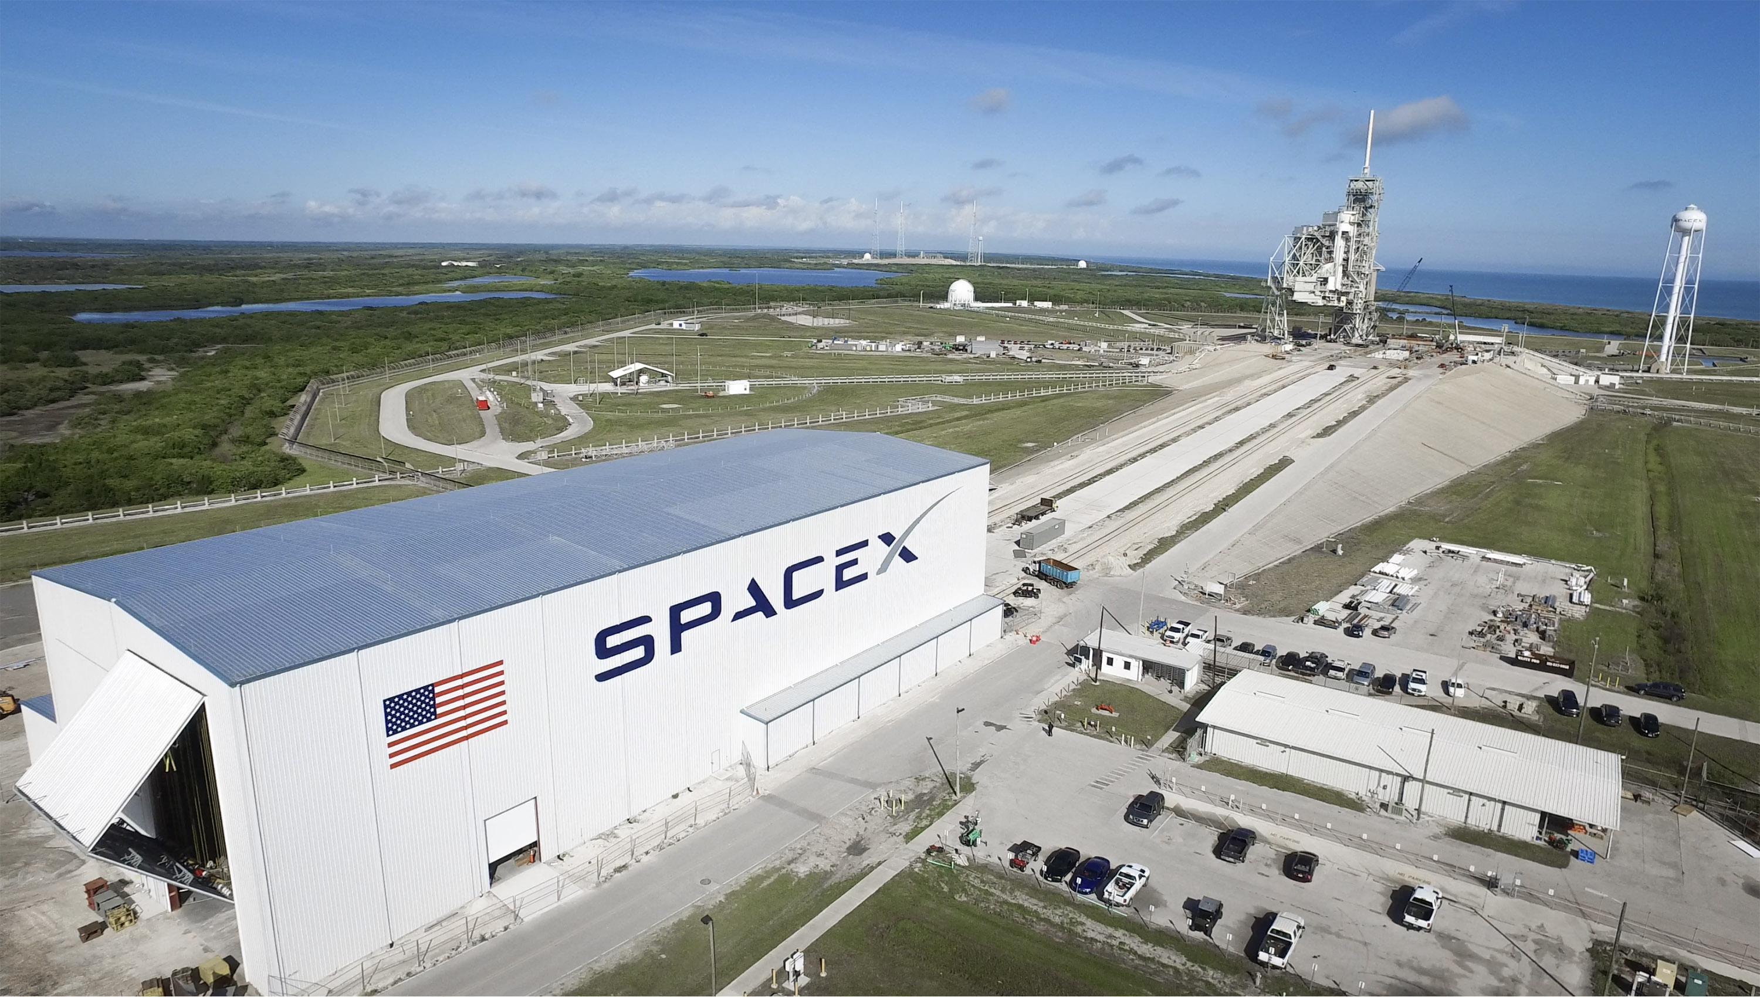
About me

Slide 4
About
Name: SpaceX
Industry: Aerospace
Founded: May 6, 2002

